Slide 1
Functions

Slide 2
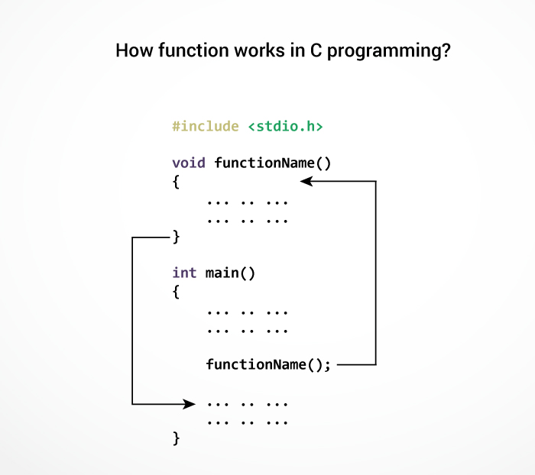
A function is a block of code that performs a specific task. function name is an identifier and should be unique.

Slide 3
return_type fun_name()
{
}

Slide 4
A user-defined function addNumbers()
#include <stdio.h>
int addNumbers(); // function prototype
int main()
{
int sum;
sum=addNumbers(); // function call
printf("sum = %d",sum);
return 0;
}
Int addNumbers() // function definition
{
int n1,n2,result;
printf("Enters two numbers: ");
scanf("%d %d",&n1,&n2);
result = n1+n2;
Return result;// return statement
}

Slide 5
Function prototype
A function prototype is simply the declaration of a function that specifies function's name, parameters and return type. It doesn't contain function body.
A function prototype gives information to the compiler that the function may later be used in the program.
Syntax :
returnType functionName(type1 argument1, type2 argument2,...);

Slide 6
Calling a function
Control of the program is transferred to the user-defined function by calling it.
Syntax
functionName(argument1, argument2, ...);
Function definition
Function definition contains the block of code to perform a specific task i.e. in this case, adding two numbers and returning it.
syntax
returnType functionName(type1 argument1, type2 argument2, ...)
{
//body of the function
}

Slide 7
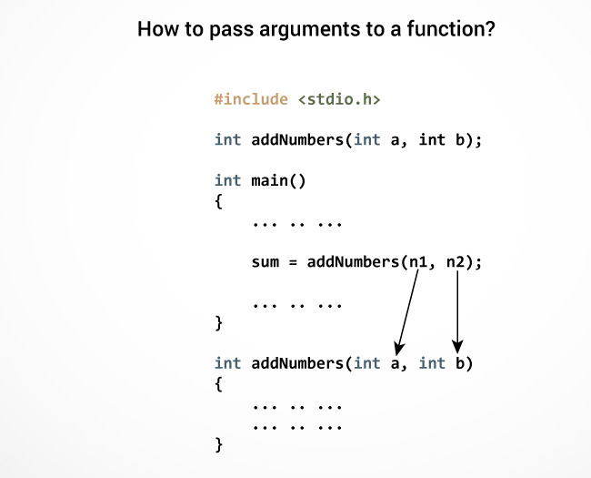

Slide 8
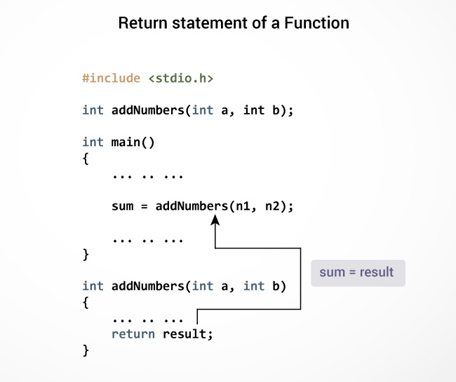

Slide 9
Types of User-defined Functions in C Programming
Function with no arguments and no return value
Function with no arguments and a return value
Function with arguments and no return value
Function with arguments and a return value.

Slide 10
No arguments passed and no return Value
#include <stdio.h>
void checkPrimeNumber();
int main()
{
checkPrimeNumber(); // no argument is passed to prime()
return 0;
}
// return type of the function is void because no value is returned from the function
void checkPrimeNumber()
{
int n, i, flag=0;
printf("Enter a positive integer: ");
scanf("%d",&n);
for(i=2; i <= n/2; ++i)
{
if(n%i == 0)
flag = 1;
}
if (flag == 1)
printf("%d is not a prime number.", n);
else
printf("%d is a prime number.", n);
}

Slide 11
No arguments passed but a return value
#include <stdio.h>
int getInteger();
int main()
{ int n, i, flag = 0;
// no argument is passed to the function the value returned from the function is assigned to n
n = getInteger();
for(i=2; i<=n/2; ++i)
{ if(n%i==0)
{ flag = 1; break; }
}
if (flag == 1)
printf("%d is not a prime number.", n);
else
printf("%d is a prime number.", n);
return 0;
}
// getInteger() function returns integer entered by the user
int getInteger()
{ int n;
printf("Enter a positive integer: ");
scanf("%d",&n);
return n;
}

Slide 12
Argument passed but no return value
#include <stdio.h>
void checkPrimeAndDisplay(int n);
int main()
{
int n;
printf("Enter a positive integer: ");
scanf("%d",&n);
checkPrimeAndDisplay(n); // n is passed to the function
return 0;
}
// void indicates that no value is returned from the function
void checkPrimeAndDisplay(int n)
{
int i, flag = 0;
for(i=2; i <= n/2; ++i)
{
if(n%i == 0)
{ flag = 1; break; }
}
if(flag == 1)
printf("%d is not a prime number.",n);
else
printf("%d is a prime number.", n);
}

Slide 13
Argument passed and a return value
#include <stdio.h>
int checkPrimeNumber(int n);
int main()
{
int n, flag;
printf("Enter a positive integer: ");
scanf("%d",&n);
// n is passed to the checkPrimeNumber() //function the value returned from the
//function is assigned to flag variable
flag = checkPrimeNumber(n);
if(flag==1)
printf("%d is not a prime number",n);
else
printf("%d is a prime number",n);
return 0;
}
int checkPrimeNumber(int n)
{
int i;
for(i=2; i <= n/2; ++i)
{ if(n%i == 0)
return 1;
}
return 0;
}

Slide 14
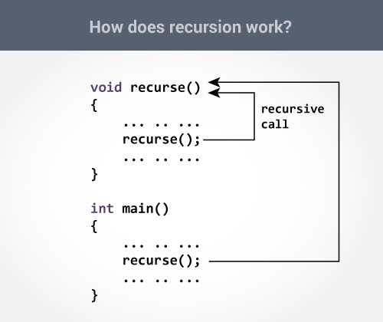

Slide 15
Sum of Natural Numbers Using Recursion
#include <stdio.h>
int sum(int n);
int main()
{
int number, result;
printf("Enter a positive integer: ");
scanf("%d", &number);
result = sum(number);
printf("sum=%d", result);
}
int sum(int num)
{
if (num!=0)
return num + sum(num-1); // sum() function calls itself
else
return num;
}

Slide 16
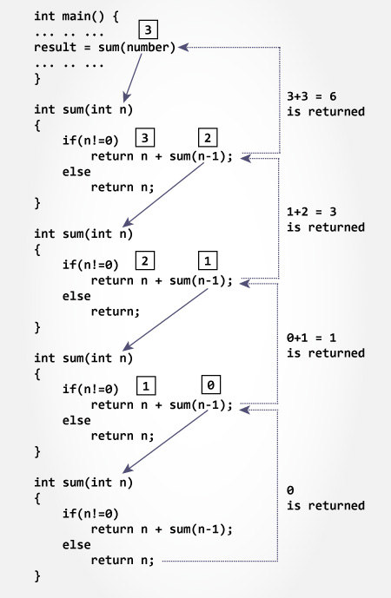

Slide 17
Local Variable
The local variables exist only inside the function in which it is declared. When the function exits, the local variables are destroyed.
int main()
{
int n; // n is a local varible to main() function
... .. ...
}
void func()
{
int n1; // n1 is local to func() function
}

Slide 18
Global Variable/External variable
Variables that are declared outside of all functions are known as external variables. External or global variables are accessible to any function.
#include <stdio.h>
void display();
int n = 5; // global variable
int main()
{
++n; // variable n is not declared in the main() function
display();
return 0;
}
void display()
{
++n; // variable n is not declared in the display() function
printf("n = %d", n);
}

Slide 19
Static Variable
The value of a static variable persists until the end of the program
#include <stdio.h>
void display();
int main()
{
display();
display();
}
void display()
{
int c = 0;
printf("%d ",c);
c += 5;
}
Output
0 5

Slide 20
C program to pass a single element of an array to function
#include <stdio.h>
void display(int age)
{
printf("%d", age);
}
int main()
{
int ageArray[] = { 2, 3, 4 };
display(ageArray[2]); //Passing array element ageArray[2] only.
return 0;
}

Slide 21
Passing an entire one-dimensional array to a function
#include <stdio.h>
float average(float age[]);
int main()​
{
float avg, age[] = { 23.4, 55, 22.6, 3, 40.5, 18 };
avg = average(age); /* Only name of array is passed as argument. */
printf("Average age=%.2f", avg);
return 0;
}
float average(float age[])
{
int i;
float avg, sum = 0.0;
for (i = 0; i < 6; ++i) {
sum += age[i];
}
avg = (sum / 6);
return avg;
}

Slide 22
Passing Multi-dimensional Arrays to Function
#include <stdio.h>
void displayNumbers(int num[2][2]);
int main()
{
int num[2][2], i, j;
printf("Enter 4 numbers:\n");
for (i = 0; i < 2; ++i)
for (j = 0; j < 2; ++j)
scanf("%d", &num[i][j]);
displayNumbers(num); // passing multi-dimensional array to displayNumbers function
return 0;
}
void displayNumbers(int num[2][2])
{
// Instead of the above line,
// void displayNumbers(int num[][2]) is also valid
int i, j;
printf("Displaying:\n");
for (i = 0; i < 2; ++i)
for (j = 0; j < 2; ++j)
printf("%d\n", num[i][j]);
}

Slide 23
Passing Strings to Functions
#include <stdio.h>
void displayString(char str[]);
int main()
{
char str[50];
printf("Enter string: ");
gets(str);
displayString(str); // Passing string c to function.
return 0;
}
void displayString(char str[]){
printf("String Output: ");
puts(str);
}

Slide 24
List of Standard Library Functions Under Different Header Files in C Programming
C Header Files
<assert.h> Program assertion functions
<ctype.h> Character type functions
<locale.h> Localization functions
<math.h> Mathematics functions
<setjmp.h> Jump functions
<signal.h> Signal handling functions
<stdarg.h> Variable arguments handling functions
<stdio.h> Standard Input/Output functions
<stdlib.h> Standard Utility functions
<string.h> String handling functions
<time.h> Date time functions

Slide 25
Passing Arguments
Call by value
Copy of argument passed to function
Changes in function do not effect original
Use when function does not need to modify argument
Avoids accidental changes
Call by reference
Passes original argument
Changes in function effect original
Only used with trusted functions

Slide 26


Return Statement
return;
return expression;
Unlike Python C can return only value

Slide 27
Return only value
#include<stdio.h>
int main()
{
//char r;
//r=test();
int r=test();
printf("%d",r);
return 0;
}
int test()
{
int a=10,b=20;
return (a>b?a:b);
//return (a>b?'a':'b');
}

Slide 28
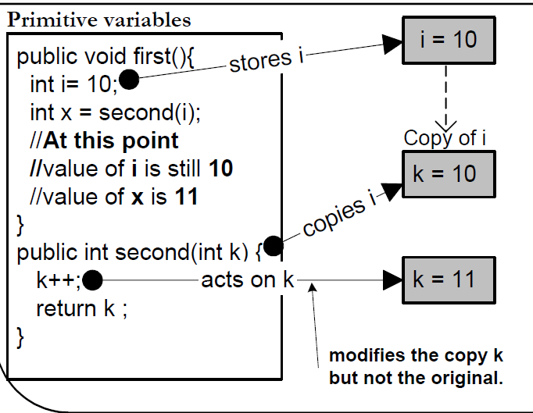
Pass by Value

Slide 29
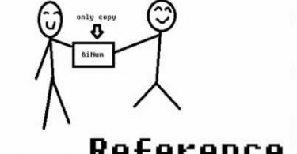

Slide 30
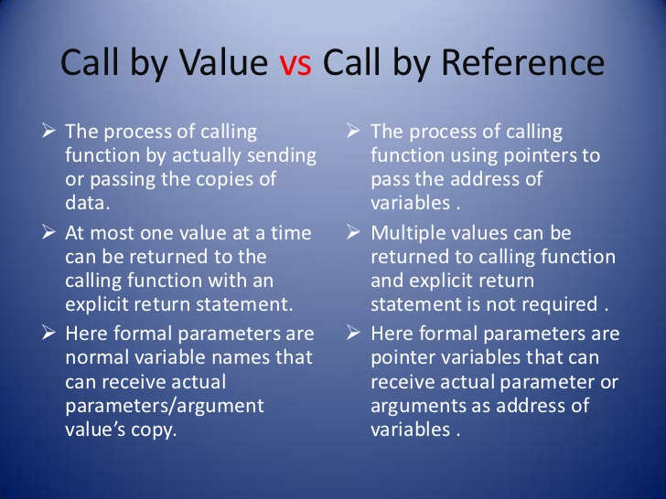

Slide 31
Pass by Address or Reference
Address of variable is passed
Pointer variables are used in function declaration and definition
Address of variable is got by prefixing variable name with an ‘&’
Pointer variables are declared with a ‘*’ in front
An integer pointer variable is declared as
int* a;
Value of an address is got by using ‘*’ operator

Slide 32
Call by Reference
#include <stdio.h>
void swap(int *, int *);
int main () {
int a = 10;
int b = 20;
printf("Before swap\n");
printf("a : %d\n", a );
printf("b : %d\n", b );
swap(&a, &b);
printf("After swap\n");
printf("a : %d\n", a );
printf("b : %d\n", b );
return 0;
}
void swap(int *x, int *y)
{
int temp;
temp = *x;
*x = *y;
*y = temp;
}

Slide 33
#include<stdio.h>
float average(float age[]);
int main()
{
float s,sum=0,age[] = { 23.4, 55, 22.6, 3, 40.5, 18 };
for (int i = 0; i < 6; ++i) {
sum += age[i];
}
printf("sum age=%.2f", sum);
s = average(age); /* Only name of array is passed as argument. */
printf("\nFrom function sum age=%.2f", s);
return 0;
}
float average(float age[])
{
int i;
float sum = 0.0;
for (i = 0; i < 6; ++i) {
age[i]=10;
sum += age[i];
}
return sum;
}

